Slide 1
Biology of Fertility Control

Slide 2
What You Should Know
Infertility treatments and contraception are based on the biology of fertility.
Risks and ethics associated with fertility treatments.
Fertile periods.
Cyclical fertility in females leading to a fertile period.
Continuous fertility in males.
Calculation of fertile periods and their use.
Treatments for infertility.
Ovulation stimulated by drugs that prevent the negative feedback effect of oestrogen on FSH secretion.
Artificial insemination.
Several samples of semen are collected over a period of time. If a partner is sterile a donor may be used.
Intra-cytoplasmic sperm injection (ICSI).
If mature sperm are defective or very low in number ICSI can be used — the head of the sperm is drawn into a needle and injected directly into the egg to achieve fertilisation.
In vitro fertilisation (IVF).
Surgical removal of eggs from ovaries after hormone stimulation. Incubation of zygotes and uterine implantation. Pre-implantation genetic screening to identify genetic disorders and chromosome abnormalities

Slide 3
The Biology of Controlling Fertility
Infertility treatments and contraception are based on the biology of fertility.
Fertility
Males are continuously fertile
Female fertility is cyclical

Slide 4
Infertility in Females
Estimate 30-40% of Scots have fertility problems
Failure to ovulate due to
-hormonal imbalance
-stress
Blocked oviducts
-Infections (STI’s)
-Fibroids
-Spasms
Implantation failure
-Hormonal imbalance

Slide 5
Infertility in Males
Low sperm count (<20 million sperm / ml), abnormal sperm, low motility
Hormonal problems due to
-Stress
-Poor diet
-Smoking, alcohol, drugs

Slide 6
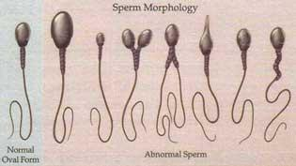

Slide 7
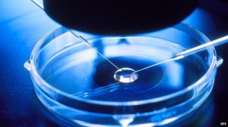
Treatments for Infertility
Fertility drugs which stimulate ovulation
Artificial insemination
Intra-cytoplasmic sperm injection (ICSI )
In vitro fertilisation (IVF)

Slide 8
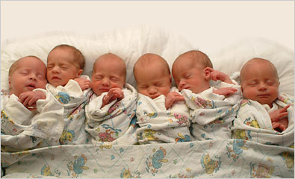
Female Fertility Drugs
Failure to ovulate can be treated with drugs that mimic FSH and LH
Stimulate follicle development & ovulation
Drugs can also be given to prevent negative feedback effect of oestrogen
Stimulates production of more FSH
Several Graafian follicles develop
When drug is stopped, LH is released
Ovulation occurs
These drugs can cause super ovulation resulting in multiple births or the production of many eggs for IVF

Slide 9
Artificial Insemination

Slide 10
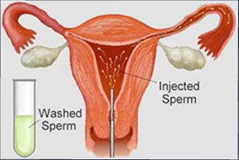
The average sperm count in men is 20 to 150 million per millilitre of semen
Low sperm count classified as fewer than 20 million sperm per millilitre of semen
Artificial insemination is used to treat problems with sperm count
Sperm are placed inside the uterus, near an oviduct using a catheter
If male is sterile sperm from a donor can be used

Slide 11
IVF Treatment

Slide 12
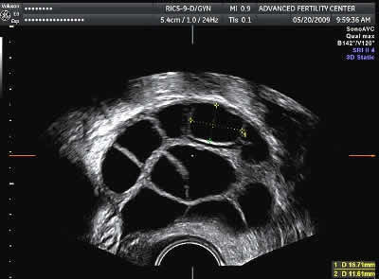
IVF
Hormonal treatment stimulates development of multiple follicles
Scan to confirm follicles are mature
Eggs removed using a hollow needle

Slide 13
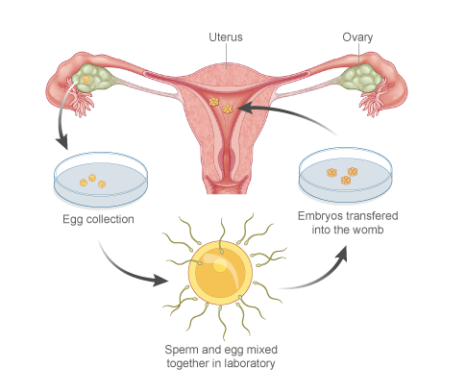
Sperm collected and “best” selected
Sperm & eggs combined in a dish containing nutrient medium
Fertilised eggs incubated until they have formed at least 8 cells
Healthiest embryos selected

Slide 14
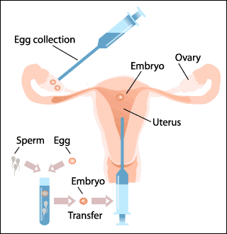
More hormonal treatment (progesterone)
Scan to check thickness of endometrium
Maximum of 2 embryos transferred via thin catheter to uterus for implantation

Slide 15
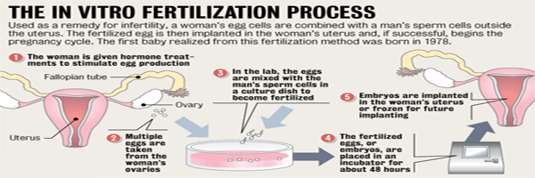

Slide 16
ICSI

Slide 17
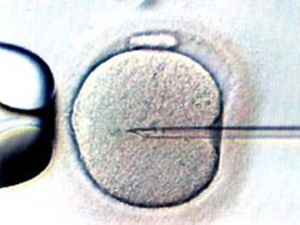
Intra-cytoplasmic sperm injection (ICSI).
If mature sperm are defective or very low in number ICSI can be used
the head of the sperm is drawn into a needle and injected directly into the egg to achieve fertilisation.

Slide 18
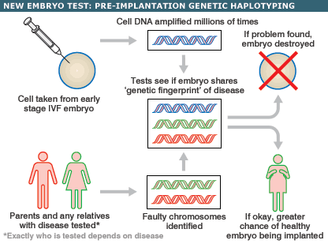
Pre-implantation Genetic Screening (PGS)
Pre-implantation genetic screening to identify genetic disorders and chromosome abnormalities.

Slide 19
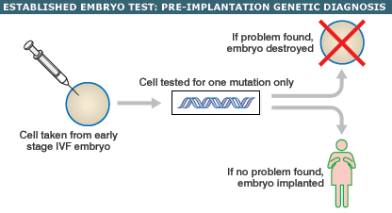
Pre-implantation Genetic Diagnosis (PGD)
Pre-implantation genetic diagnosis to identify a known chromosomal or gene defect

Slide 20
Risks and Ethics Associated with Fertility Treatments
In groups discuss the risks and ethics of fertility treatments
Include pros and cons of fertility treatment
Produce a short summary of your discussion

Slide 21
Contraception

Slide 22
What You Should Know
Contraception — physical and chemical methods of contraception
Biological basis of physical methods.
Chemical contraceptives are based on combinations of synthetic hormones that mimic negative feedback preventing the release of FSH/LH.

Slide 23
Contraception is the intentional prevention of conception or pregnancy by natural or artificial means

Slide 24
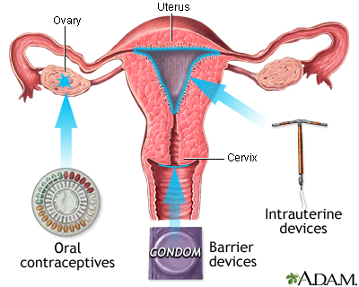
Physical Methods of Contraception
Barrier methods use a device to physically block the sperm from reaching the ova
Intra uterine devices (IUD)
Condom
Diaphragm
Cervical cap
Sterilisation procedures

Slide 25
Chemical Contraception
Hormonal methods
Combinations of synthetic hormones
Mimic negative feedback by preventing release of FSH/LH
Some prevent implantation (‘morning-after pills’)
some cause thickening of cervical mucus (‘progesterone- only pill’).

Slide 26
