Slide 1


Coronavirus: Covid-19 outbreak
Full lesson plan from redcross.org.uk/education

Slide 2
Definitions activity: what is coronavirus?

Slide 3
Coronavirus
A large family of viruses
Covid-19
Getting unnecessarily large amounts of a product
Misinformation
Staying indoors, avoiding contact with other people
Separating people known or believed to be infected with a disease from the public
Pandemic
Panic Buying
False stories that are presented as being true
Quarantine
A new strain of coronavirus
Social Distancing
Staying away from gatherings and not standing close to other people
Self-isolation
A new disease that spreads around the world beyond expectations

Slide 4
Coronavirus
A large family of viruses
Covid-19
A new strain of coronavirus
Misinformation
False stories that are presented as being true
Pandemic
A new disease that spreads around the world beyond expectations
Panic Buying
Getting unnecessarily large amounts of a product
Quarantine
Staying indoors, avoiding contact with other people
Social Distancing
Staying away from gatherings and not standing close to other people
Self-isolation
Separating people known or believed to be infected with a disease from the public

Slide 5
Poster activity

Slide 6
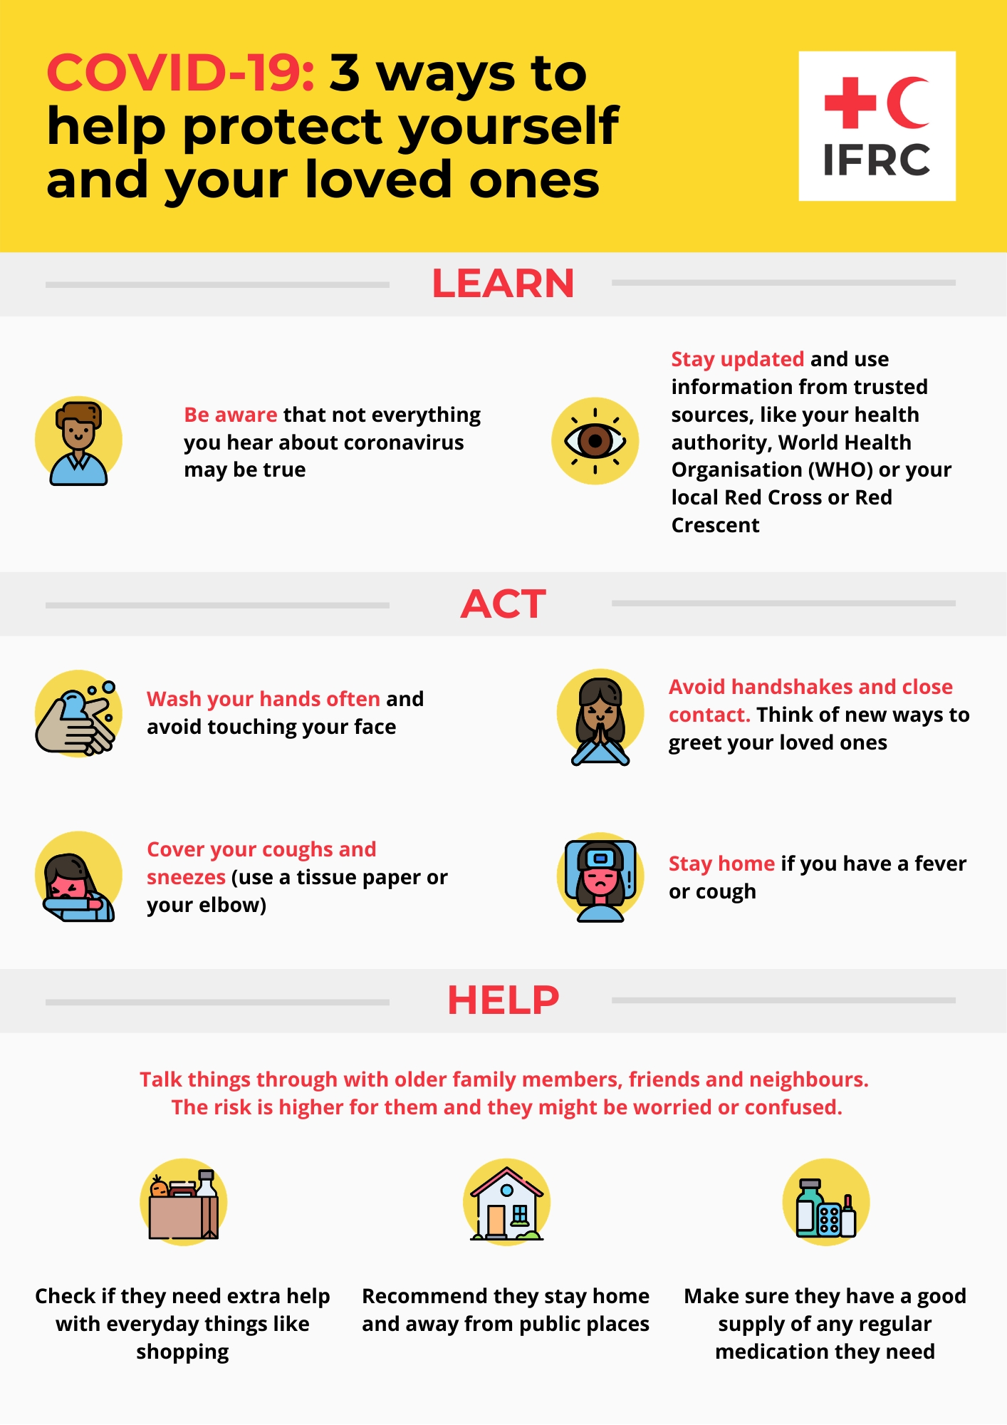

Slide 7
Quiz activity: how can you spot misinformation?

Slide 8
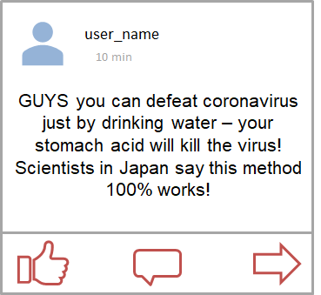
1. Trust or not?

Slide 9
1. Think again
Drinking water when you are sick is always a good thing, but it is not a 'cure'..
There is no source or evidence to back up this claim.
Eating garlic is also not a cure!

Slide 10
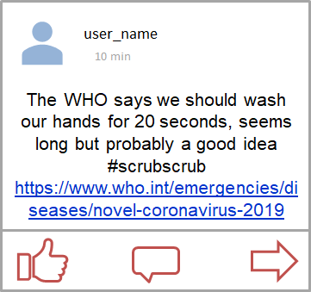
2. Trust or not?

Slide 11
2. Trust
Washing your hands with soap and water for 20 seconds is the scientifically proven way to kill the most germs.
Their claim is supported by a link to a trusted source so you can check yourself.

Slide 12
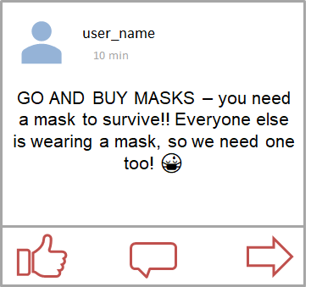
3. Trust or not?

Slide 13
3. Think again
Masks are not
recommended.
They are only useful for
medical
professionals and those who already have the virus to stop spreading it.
Panic buying anything is harmful to others and often unnecessary.

Slide 14
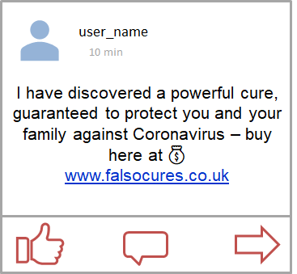
4. Trust or not?

Slide 15
4. Think again
There are no current
scientifically tested and safe cures against
Covid-19. But scientists are working on it.
Be careful when following unknown links. People selling things will try and convince you that you need them.

Slide 16
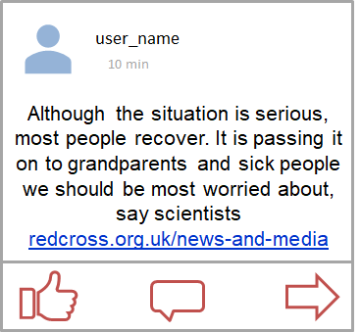
5. Trust or not?

Slide 17
5. Trust
This is what scientists think at the moment.
It is backed up by a trusted news source.

Slide 18
Kindness and resilience

Slide 19
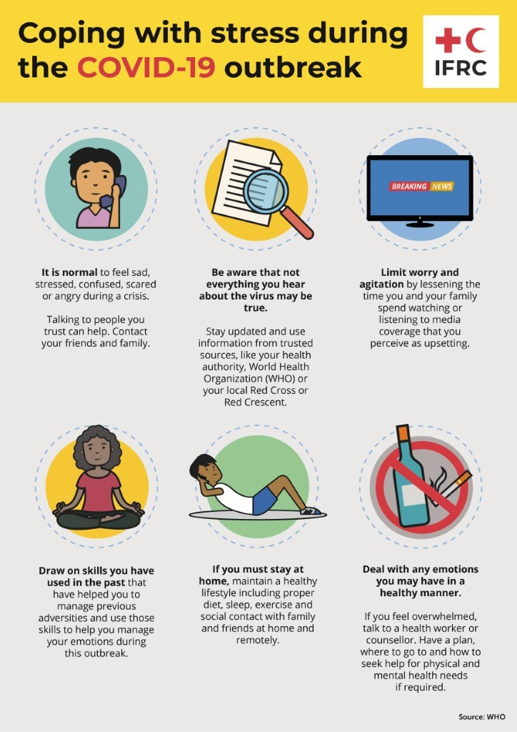

Slide 20
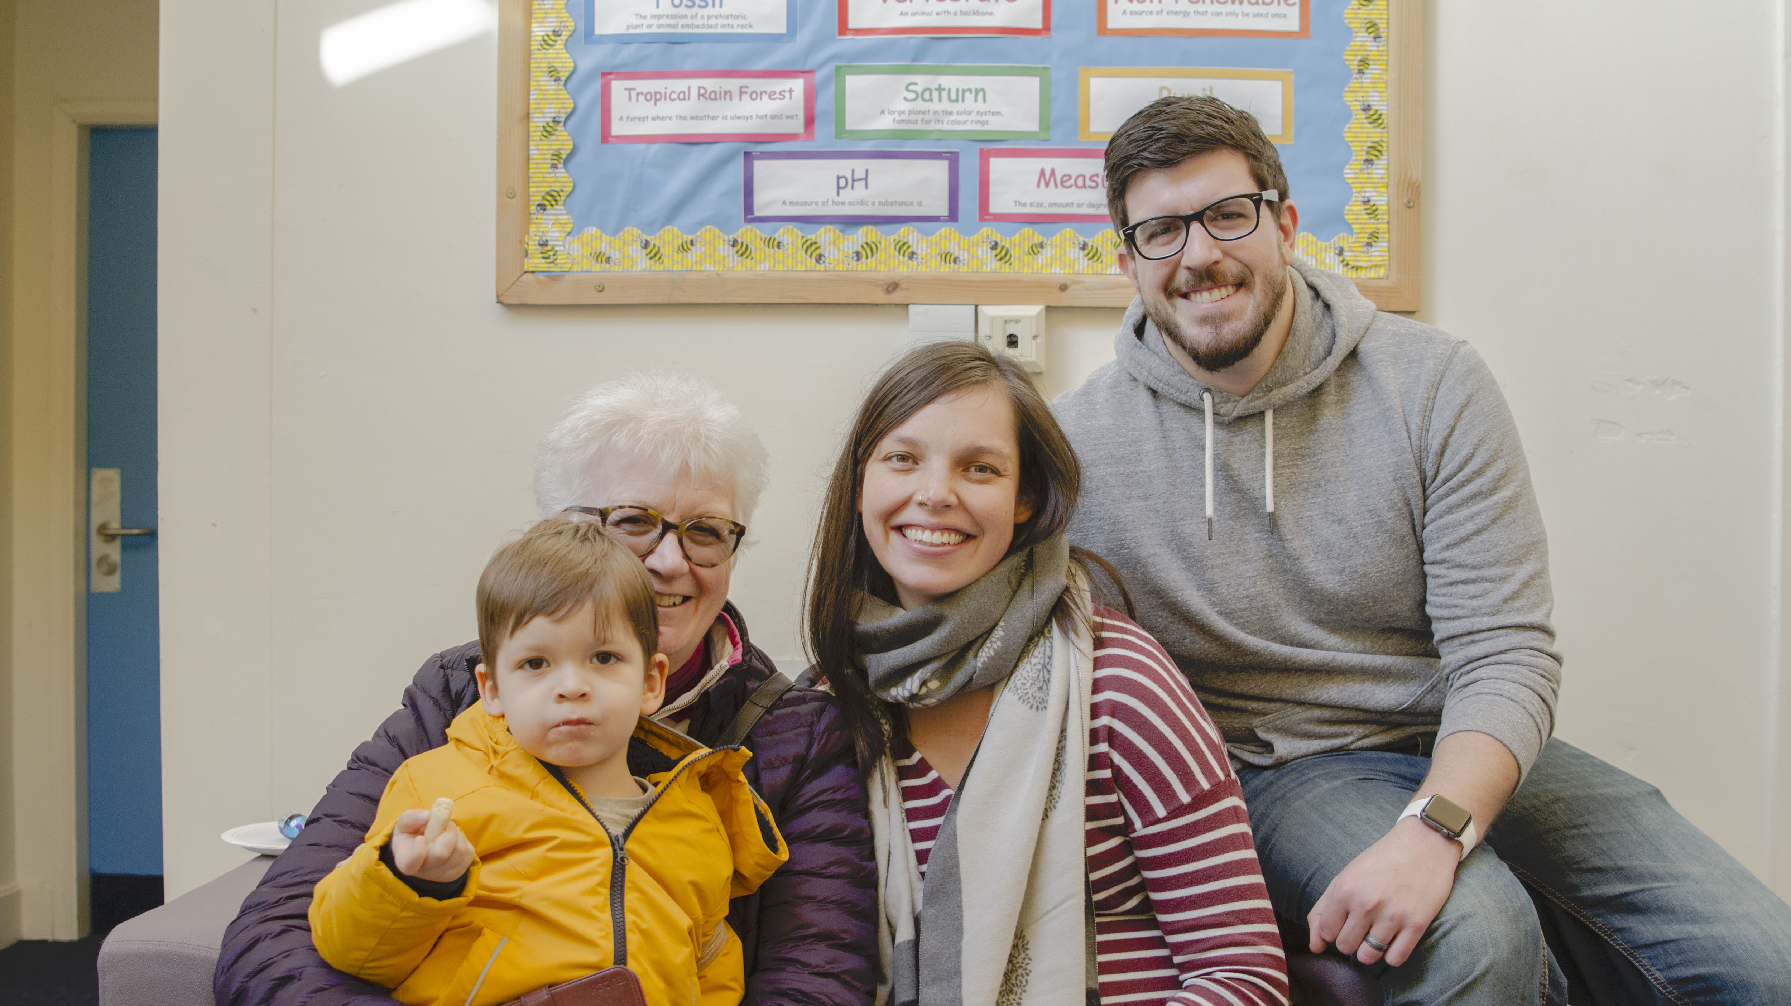
© Naeem Khan/British Red Cross

