Slide 1
Orkney Inter-agency Child Protection Guidelines
Key Information

Slide 2
Where to Find the Guidance
https://growingupinorkney.co.uk/wp-content/uploads/2022/02/Orkney-Inter-agency-Child-Protection-Guidelines.pdf

Slide 3
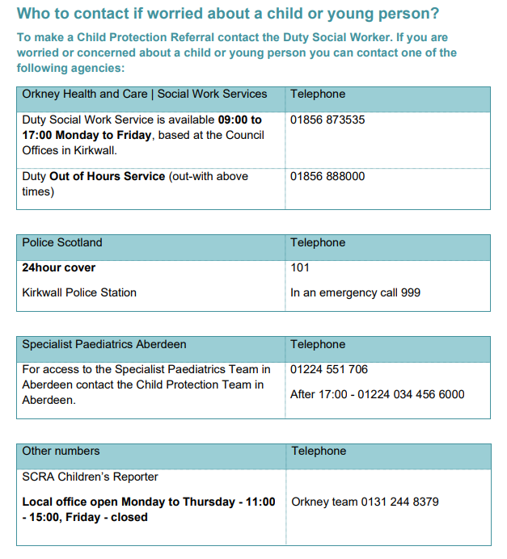
Key Contacts

Slide 4
Background
“It’s everyone’s job to make sure I’m alright.” Report of the Child Protection Audit and Review 2002, has a central message that everyone has a responsibility for ensuring all our children and young people are safe and should not be left in abusive or neglectful circumstances.
Orkney Public Protection Committee, working with partners, has developed the local Inter-agency Child Protection Guidelines for use by staff in Education Services, Health Services, Social Work Services, Police Scotland and for reference by Third Sector partners and anyone who has a concern about the welfare of a child or young person in Orkney.
These guidelines provide a step-by-step guide on how to refer and respond to child protection concerns. They apply to all agencies including Third Sector organisations.

Slide 5
Background
The guidelines are based on the principles of working together and supporting inter-agency colleagues to:
• Recognise
Be aware that a child or young person may be at risk of significant harm and may need support and protection
• Respond
Take immediate action to ensure the safety of children and young people
• Report or Refer
Follow Child Protection Guidelines and Child Protection Procedures as required
• Record
Record information on presenting circumstances, actions, decisions and feedback

Slide 6
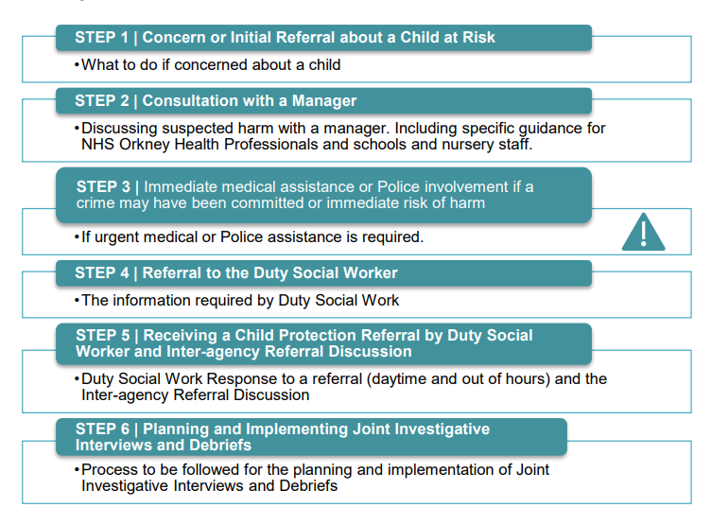
Steps for Making a Referral

Slide 7
Step 1-Concern or Initial Referral about a Child at Risk
Any person who witnesses, suspects or receives information that a child or young person may be at risk, has a duty to report that information immediately.
If the child or young person requires urgent medical attention or urgent Police protection, go to Step 3.
If the child or young person has an obvious injury, you should seek an explanation from them or their parents. Record the explanation provided. If a child or young person speaks about experiences of physical harm, neglect, sexual abuse or emotional abuse, listen carefully, seek clarification of what they are saying and record their account.
You should explain you cannot keep this confidential and will have to speak to your Line Manager.
You should seek advice and make a Child Protection Referral if the information indicates the child or young person may be at risk.

Slide 8
Step 2 – Consultation With a Line Manager
As a member of School or Nursery staff, when you have a concern a child may be at risk, you should seek the advice of a designated person in the school (usually a Head Teacher or Deputy) as soon as possible.
As School and Nursery staff, you must ensure that no situation, where a child is potentially at risk, is left until the end of the school day. Service Managers based in the Council Offices will assist any member of staff who has a concern about a child’s safety and who is unable to contact a designated person in the school quickly.
A copy of the Child Protection Referral made by school staff will be retained for school files and a copy sent to the Head of Education at the Council Offices.
Early Learning and Childcare Managers or Head Teachers are responsible for ensuring that nurseries notify the Care Inspectorate if they make a referral.

Slide 9
Step 3 – Immediate Medical Assistance of Police Involvement
If urgent medical assistance is required, you should take the child or young person to Accident and Emergency at Balfour Hospital or phone for an ambulance.
Where there is a report or suspicion of a crime, or if immediate Police assistance is required, you can make a Child Protection Referral directly to the Police in an emergency by phoning 999.
If the safety of the child, young person or staff member is at immediate risk and Police assistance is required, you should contact the Police.
You must record all action taken and discuss it with a Line Manager as soon as possible – but do not delay summoning emergency help.

Slide 10
Step 4 – Referral to the Duty Social Worker
As a referrer, you should say who you are, what your role is with the child, and the nature of your concerns. You should share verbally and confirm in writing, your concerns including the following information:
What your concerns are;
Name, address, date of birth, family composition, siblings, parents, carers;
What has been observed or heard and what sense has been made of the information;
Referrers should try to be clear about what is “fact” and what is “opinion” and the source of the information.
Details of the alleged perpetrator if known;
Details of any specific incidents – dates, times, witnesses, any visible injuries;
Where the child is now, including who last saw the child and when;
Relevant background information about the child or history of previous concerns;
If there is a Named Person or a Child’s Plan co-ordinated by a Lead Professional;
Information indicating an adult may be at risk;
Any additional support needs requiring specialist assistance to communicate with the child;
Safety factors e.g. family, friends or support staff and immediate care arrangements.

Slide 11
Step 5 - Receiving a Child Protection Referral by Duty Social Worker and Inter-agency Referral Discussion
For referring adults, the Duty Social Work service is available on Tel: 01856 873535, from 09:00 to17:00. Monday to Friday, based at the Council Offices in Kirkwall.
Duty Out of Hours Service out-with Monday to Friday 09:00 – 17:00. Tel: Balfour Hospital Switchboard 01856 888000.
As a referring adult, if you believe help for an emergency is required or the risk to a child cannot wait until the next morning, you can obtain help at any time of the day or night by contacting the Duty Social Work service.
A Duty Social Worker will gather information to inform an initial risk assessment and Inter-agency Referral Discussion (IRD) with the IRD Sergeant, Police Scotland

Slide 12
Step 5 - Receiving a Child Protection Referral by Duty Social Worker and Inter-agency Referral Discussion
IRDs are discussions with the Police, Health and Social Work about concerns which have been presented.
A full description of the purpose of an IRD can be found in the guidance, but includes:
Collate information and establish the facts;
Decide if any investigation into the circumstances of the child should be conducted
Consider the need for a medical examination
Agree the nature of the child protection enquiries and the criminal investigation

Slide 13
Step 5 - Receiving a Child Protection Referral by Duty Social Worker and Inter-agency Referral Discussion
A Duty Social Worker or Investigating Social Worker will inform the staff member or concerned adult who made the Child Protection Referral of the outcome within 7 working days
Where for any reason, as a referring organisation you have not received feedback from a partner agency, you must seek feedback. Where feedback is not forthcoming, you must escalate this to your Line Manager.

Slide 14
Step 6 – Planning and implementing Joint Investigative Interviews and Debriefs
The JII is a formal planned interview with a child carried out by trained and competent staff to hear the child’s account of events which require investigation.
In all cases, the decision to proceed with a JII will be taken by the Police and Social Work, taking account of relevant information from partner agencies.
The Purposes of the Investigative Interview are to:
Hear the child’s account of the circumstances that prompted the enquiry;
Gather information to inform decision making on whether the child or young person or any other child, may need protection;
Gather evidence if a crime has been committed against the child, young person or anyone else;
Gather evidence which may lead to Grounds of Referral to the Children’s Reporter.

Slide 15
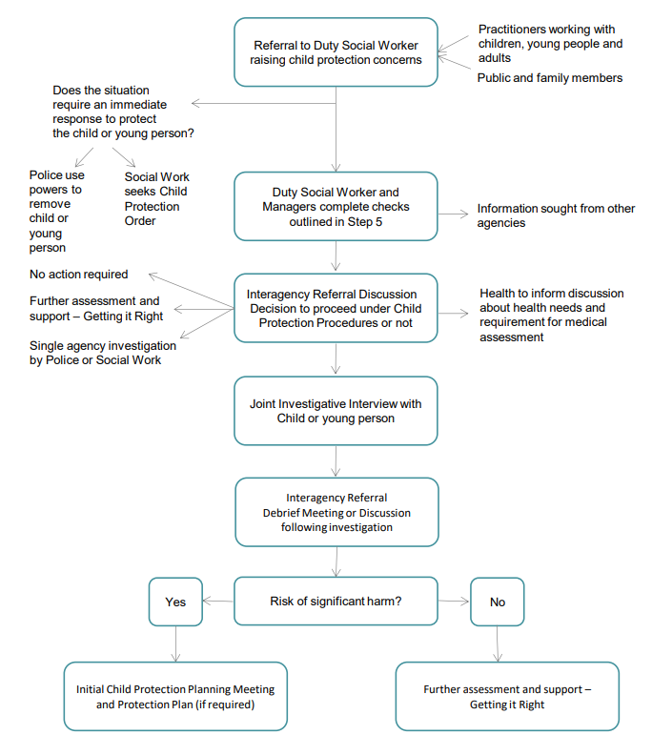
Process for Referral Flowchart

Slide 16
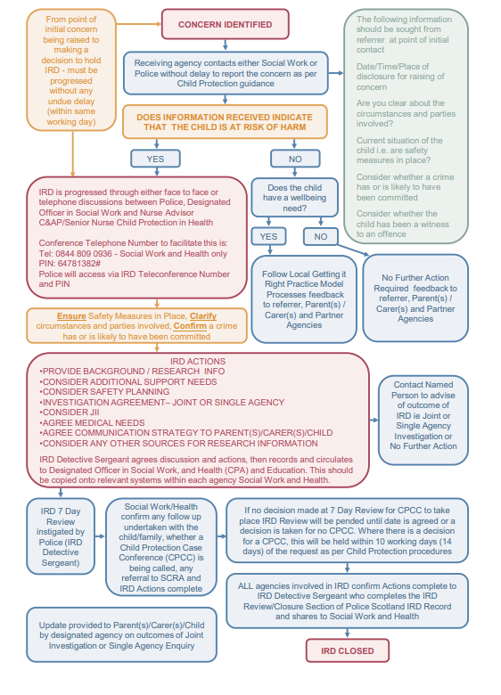
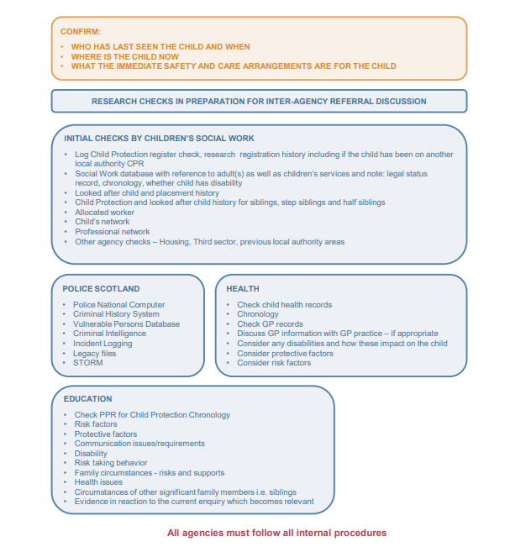
Highlands and Islands IRD Protocol

Slide 17
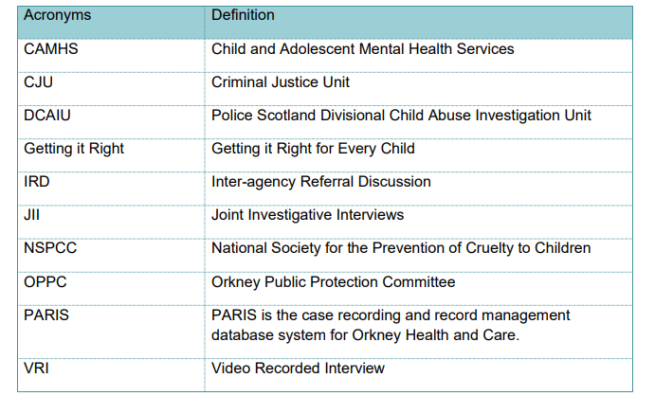
Acronyms

